Slide 1
College Success
Module 1: Study Skills
Notes:
Cover Image: "Graduacion." Authored by: Melissa B. Cortez. Provided by: Unsplash. Located at: https://unsplash.com/photos/rG0O-qJ7-Q0. Content Type: CC Licensed Content, Shared Previously. License: CC0: No Rights Reserved.

Slide 2
Take the first 10 minutes of class and answer the following question on a piece of paper for discussion later in class:
What are 2 study skills and 2 test taking strategies that have made you most successful in school so far?

Slide 3
How to Study Effectively for School or College (Watch the video below and take notes)
https://youtu.be/CPxSzxylRCI
Notes:
We start every module with “Why It Matters” as an informal introduction to what students will cover in this course module.
Guiding Question:
What are some ways that you would advise student to learn how to effectively prepare for different assignments? What are some ways student can use their skills to shape their later studies?
Waymaker Tip:
While you’re discussing study skill strategies, this might be a great time to pause and review “Succeeding with Waymaker,” the module on using Waymaker as a student. Ask students about how they are using the Study Plan and how they are studying with the course material.

Slide 4
ANSWER Method: For effective study skills
Ask, Explain and Connect Ideas
No cramming: Spaced Practice
Switch subject matter: Interleaving
Words with visuals: Dual Coding
Examples: Specific, concrete examples
Recall what you know: Retrieval Practice
Notes:
You can access the learning outcomes for this course here: https://courses.lumenlearning.com/wmopen-collegesuccess/chapter/learning-outcomes/

Slide 5
Ice Breaker: Study Skills Discussion
What are 3 examples of how you could use the ANSWER method to be successful in your future courses?
Why is it important to use Spaced Practice when you are at home studying?
What are ways that you will practice Recalling information while studying?

Slide 6
Ask, Explain and Connect Ideas: Elaborate
Connect ideas with your daily experiences
Create how and why questions to know how they are similar and difference
Make a list of ideas you need to learn
Look for answers to your own questions in the learning material
Notes:
Here are some reasons listed in the text:
Academic sources such as textbooks and scholarly journal articles are usually written by experts in the field and have to pass stringent peer review requirements in order to get published. Since many college reading assignments (especially journal articles) are written in a similar style, you’ll gain experience studying their strategies and learning to emulate them.

Slide 7
No cramming: Spaced Practice
Spread your study time out
Schedule short study sessions
No interruptions in small study sessions
Notes:
Reading strategies for specialized texts and online resources:
get to know the conventions
look up and keep track of unfamiliar terms and phrases
look for main ideas and themes
get the most of online reading
look for reputable online sources
pay attention to visual information
Image: Image of man reading. Authored by: Ken Slade. Located at: https://flic.kr/p/auziyg. License: CC BY-NC: Attribution-NonCommercial

Slide 8
Switch subject matter: Interleaving
Be able to jump between ideas and know how they relate to each other
Make links between ideas as you move between them
On the next study session change orders of how you study different ideas
Notes:
From the text:
Read everything and read often.
Make connections to words you already know.
Make index cards.
For a captioned version of the video below, visit our page “Reading Strategies”: https://courses.lumenlearning.com/wmopen-collegesuccess/chapter/reading-strategies/
Video: Vocabulary Reading Strategies. Authored by: Lindsey Thompson. Located at: https://youtu.be/nfbY0EK7JEY. License: Public Domain: No Known Copyright

Slide 9
Words with visuals: Dual Coding
Look at visuals and explain in your own words what they mean
Use your own words to describe a visual
You learn best when you combine words and visuals

Slide 10
Examples: Use Specific, Concrete Examples
Use concrete instead of abstract
Use past experiences to help explain, learn and remember things
Are your examples accurate and relevant to the material you are learning
Notes:
From the text: College writing assignments require you to apply skills to new intellectual challenges. Professors assign papers because they want you to think rigorously and deeply about important questions in their fields. To your instructors, writing is for working out complex ideas, not just explaining them. A paper that would earn a top score on the SAT might only get a C or D in a college class if it doesn’t show original and ambitious thinking.

Slide 11
Recall What You Know: Retrieval Practice
Put away all of your textbooks and recall what you already know
Practice recalling information often
Focus your study time on the information that you can’t recall
Use practice tests multiple times
Check your knowledge against course material
Notes:
From the text:
Summary assignments
reflect accurate understanding of thesis
differentiate between major and minor ideas in a source
identify key phrases to quote
effective paraphrases most of the source’s ideas
capture tone, style, and distinguishing features of a source
does not reflect personal opinion about source
Where defined-topic essays demonstrate your knowledge of the content, undefined-topic assignments are used to demonstrate your skills- your ability to perform academic research, to synthesize ideas, and to apply the various stages of the writing process.

Slide 12
Testing Strategies

Slide 13
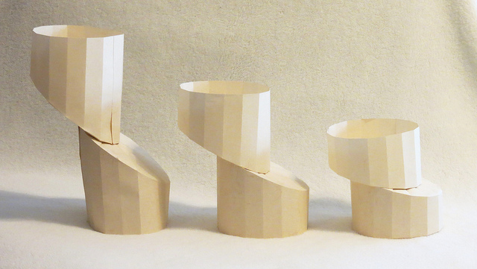
Common Types of Tests in College
Pre-Assessment
Multiple Choice Assessment
Fill-in-the-Blank Assessment
Essay Assessment
Group Assessment
Verbal Assessment
What is the purpose of testing?
Notes:
Test types:
multiple choice
true or false
matching
fill in the blank
essay
oral test
physical skills test
Purpose of testing: Your professors need to know as much as possible about what you know, think, or can do and how you differ from other students. Testing is one way to do that- to gauge how you learn, what you learn, and what you can do with what you’ve learned. By knowing more about these aspects of you as a student, your teachers are better able to serve.
Image: Image of paper columns. Authored by: Rebecca Gieseking. Located at: https://flic.kr/p/fBXyhs. License: CC BY: Attribution

Slide 14
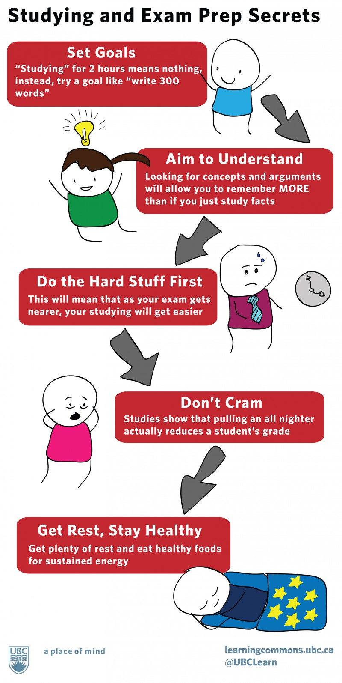
Strategies for Answering Questions
Test Taking Strategies:
Take a deep breath and relax
Remember that you have studied and be confident in what you know
Look at entire test before you begin
Ask any questions you have before you start
Budget your time based on time per question
Watch for key testing words like analyze, define, evaluate, and illustrate
Look over your exam before you are finished
Notes:
From the text:
View link below for BYU’s test preparation tips:
http://cpms.byu.edu/newsletters/StudentNews/2011/04/03/weekly/finals.pdf
View link below for video explaining how to prepare for an exam:
https://youtu.be/16ycJsAgxoo
Image: Studying and Exam Prep Secrets. Provided by: UBC Learning Commons. Located at: http://learningcommons.ubc.ca/student-toolkits-2/preparing-for-exams/. License: CC BY: Attribution

Slide 15
Test Anxiety
Strategies for preventing and controlling test anxiety:
Ask about the exam
Take inventory of your notes
Set a study schedule
Keep your diet consistent
Don’t stop exercising
Get regular sleep
Make a five-day study plan for each exam
Notes:
From the text:
Effects of testing anxiety:
being distracted during a test
having trouble organizing or recalling relevant information
having difficulty comprehending relatively simple instructions
negative attitudes towards self, school, subjects
crying
illness
eating disturbance
high blood pressure
acting out
toileting accidents
sleep disturbance
cheating
View link below for video on test-taking strategies:
https://youtu.be/Z5Ru8sx5d1c

Slide 16
Complete the following before next class:
Assignment: The 6 Habits of Highly Successful Students
Assignment: Testing Strategies
Web Only: Study Skills Discussion Board

